Slide 1
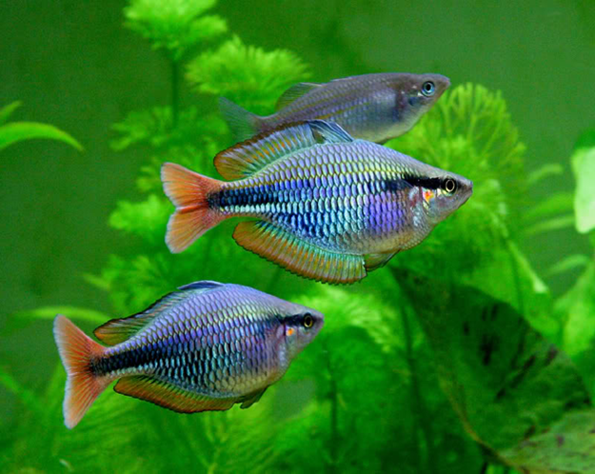
Fish diseases – (fiqcqjw)- year 5
Chapter 1 – External & Internal fish anatomy
Lecture 1
By Omeet faisel
Department of Pathology and Poultry diseases
College of Veterinary Medicin
University of Basrah
University of Basrah-College of Veterinary Medicine-Department of Pathology and Poultry diseases

Slide 2
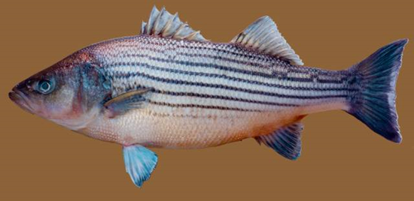
*The body: Divided into head, trunk and tail.
External fish anatomy

Slide 3
*Skin: Fish skin typically have numerous mucus-secreting skin cells that called mucous layer and .may also have poison glands

Slide 4
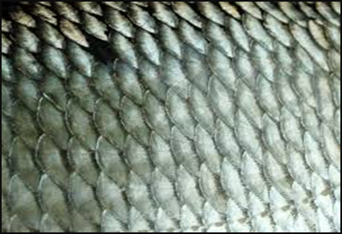
Scales: It is the outer body of many fish and act as protective layer

Slide 5
There are four principal types of fish scales
1.Placoid scales: are similar to teeth in that they are made of dentin.
2 .Ganoid scales: are flat shape, that cover a fish body with little overlapping.
3.Cycloid scales: are small oval-shaped scales.
4.Ctenoid scales: are similar to the cycloid scales. They are distinguished by spines that cover one edge.

Slide 6
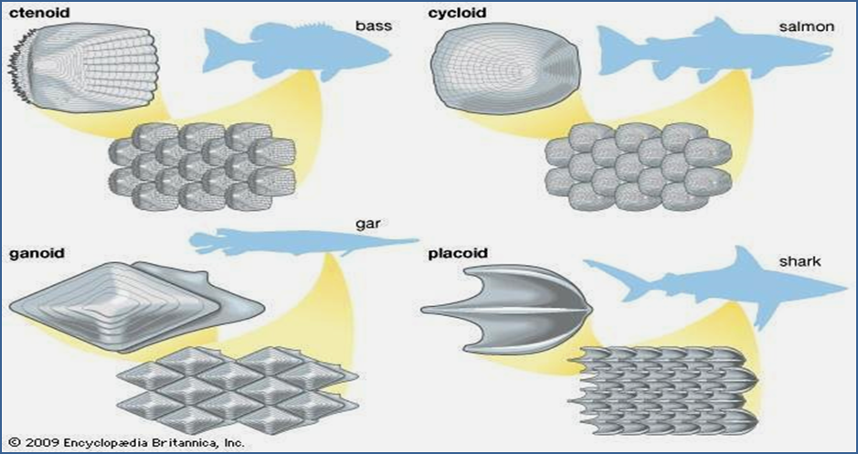

Slide 7
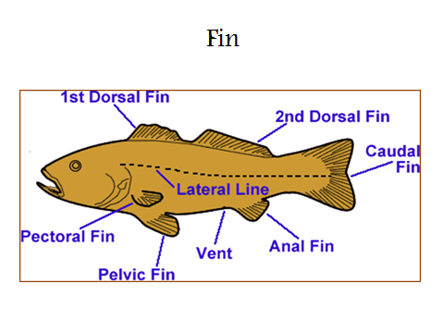

Slide 8
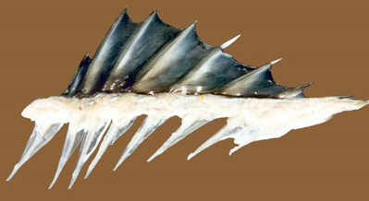
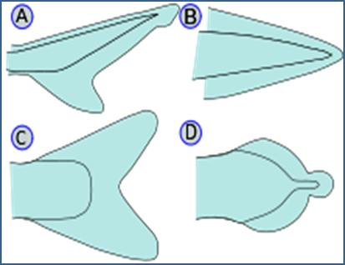
Types of fins:
الزعنفة الظهرية Dorsal fins
الزعنفة الذيلية Caudal fin: or Tail fin
الزعنفة المخرجية Anal fin
الزعنفة الحوضية Pelvic fins
الزعنفة الصدرية Pectoral fins

Slide 9
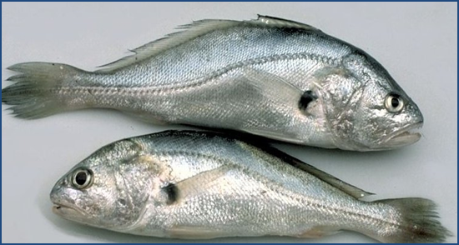
Lateral line

Slide 10
Lateral line
Is a sense organ used to detect movement, vibration in the surrounding water and is capable of determining the direction of their source. It is clearly visible is present along middle side of body. In most species, it consists of a line of receptors running along each side of the fish

Slide 11
Head: The head in fish includes many parts
Mouth
Nares (Nostrils)
Eyes
Ears
Operculum
Gills

Slide 12
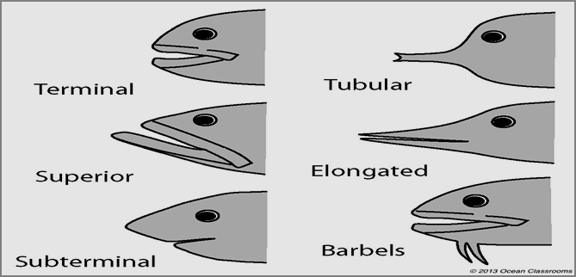
Mouth

Slide 13
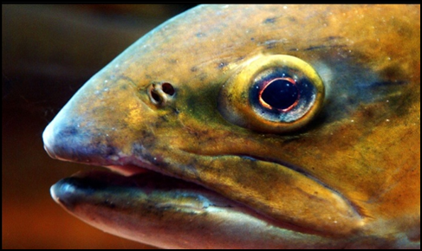
Nares (Nostrils):

Slide 14
Eyes: located in lateral position at anterior end of head. The eyes are adapted for seeing underwater and have only local vision. Some fish can see ultraviolet and some can see polarized light.
Ears: There is an inner ear but no external or middle ear, have sensory function.

Slide 15
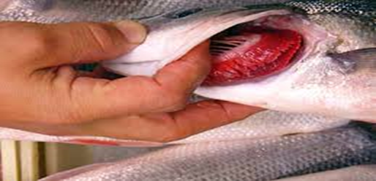
Operculum:

Slide 16
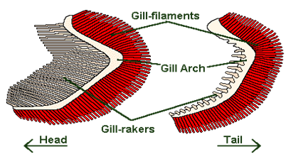
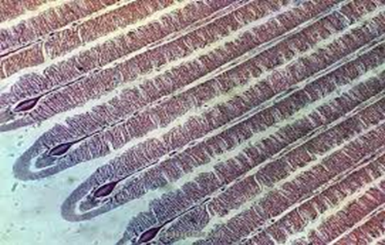
Gill: Most fish have 4 gills on each side located under the operculum

Slide 17
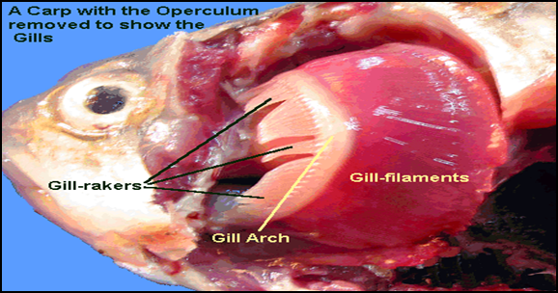
للاطلاع

Slide 18
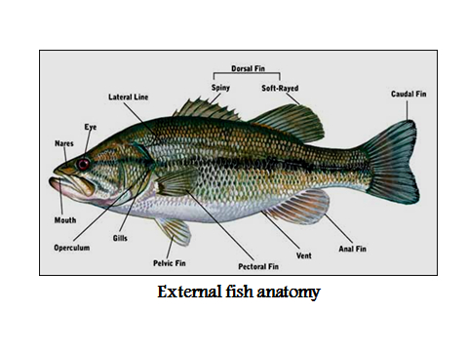
للاطلاع

Slide 19
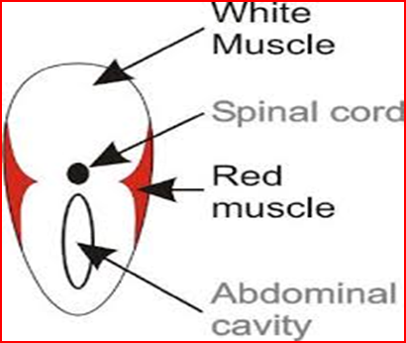
Internal fish anatomy
1-Musculoskeletal:
Muscle
Bone.
Cartilage

Slide 20
القلب والاوعية الدموية 2.Cardiovascular:
القلب heart.
جهاز الدوران Circulation
:3.Digestive
Stomach
الزوائد البوابية pyloric ceca
الامعاء Intestine
الكبد Liver
البنكرياس Pancreas

Slide 21
الجهاز اللمفي 4.Lymphoreticular:
الجهاز البولي 5. Urinary:
Kidney
جهاز التكاثر(التناسل) Reproductive:
ovaries.
testes

Slide 22
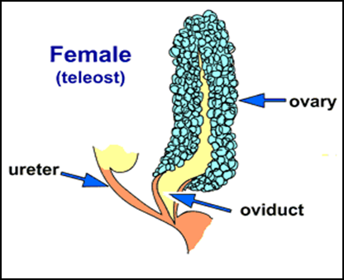
Ovary
للاطلاع

Slide 23
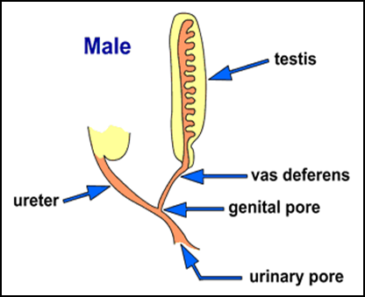
Testes
للاطلاع

Slide 24
7. Endocrine:
8. Nervous:
الدماغ Brain.
الاعصاب الدماغية cranial nerves
الحبل الشوكي spinal cord.
9. Swim bladder (Air bladder):

Slide 25
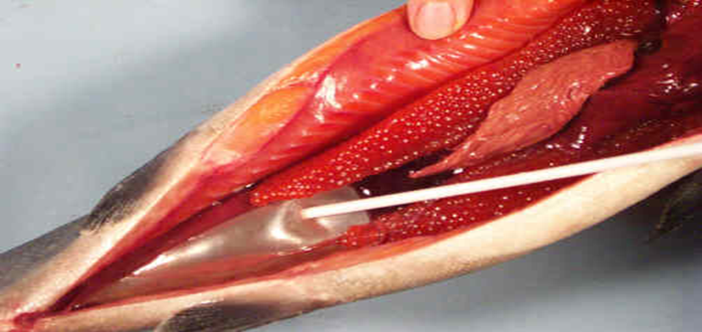

Slide 26
